Slide 1
Weekly Forecast ML Assignment
GITHUB repo: repo

Slide 2
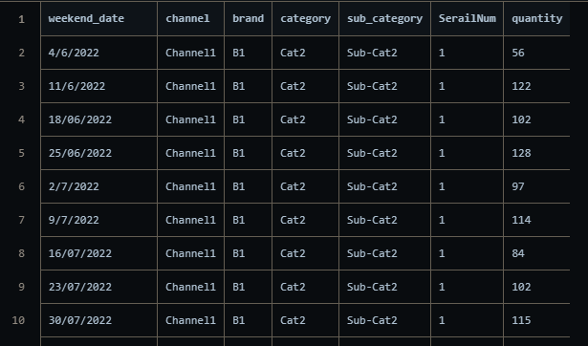
DATA
The Data is a CSV file with following attributes
Weekend date
Channel
Brand
Category
Sub category
Serial Number
Quantity

Slide 3
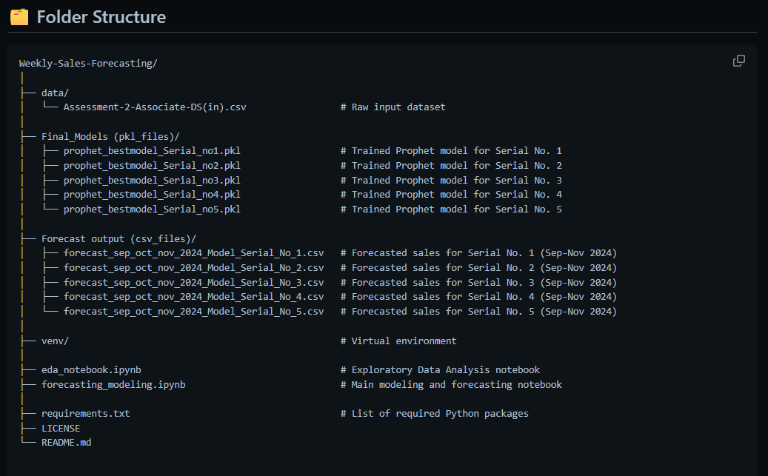
FOLDER STRUCTURE
The Project is carried out in VS Code IDE, with Jupyter Notebooks
Following are the content i.e. Deliverables of the Project

Slide 4
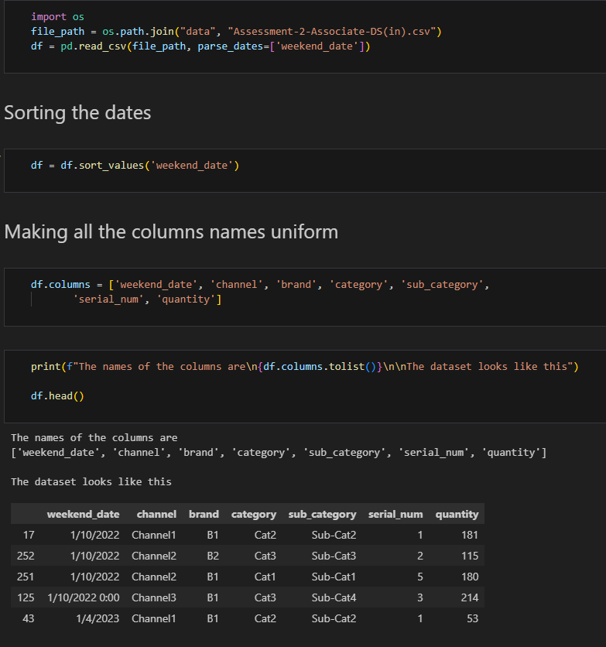
EDA notebook
Following steps are carried out in EDA Notebook:
CSV Data is read
Date Values are sorted in Ascending order
The columns of the Table are made uniform
The Data set Top 5 records are printed

Slide 5
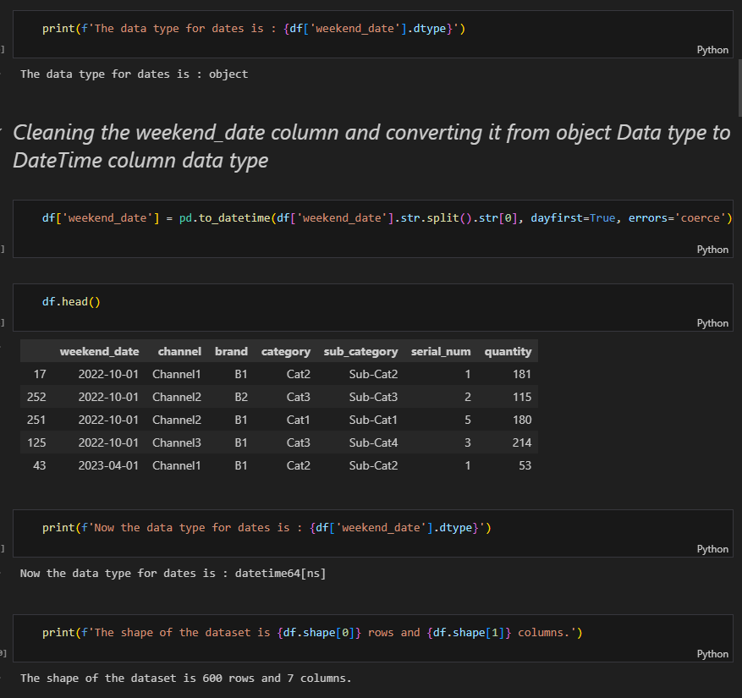
EDA notebook
Following steps are carried out in EDA Notebook:
The Data Type of dates column is found to be Object
The Dates Column is cleaned and converted to Datetime Data type
The Dataset is printed
The Shape of the Dataset is printed with 600 Rows and 7 Columns

Slide 6
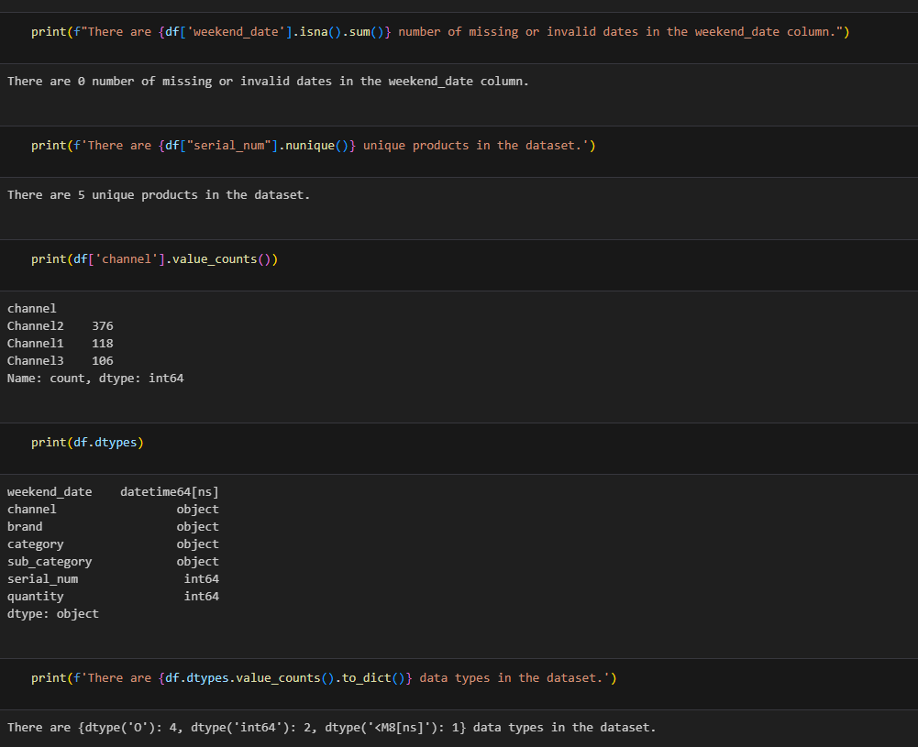
EDA notebook
Following steps are carried out in EDA Notebook:
There are 0 number of missing or invalid dates
There are 5 unique products in the dataset
We calculate the counts for each channel
We find the data types for each columns

Slide 7
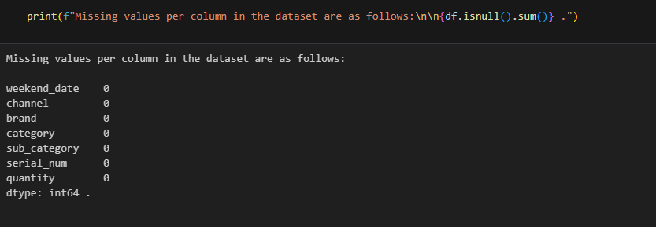
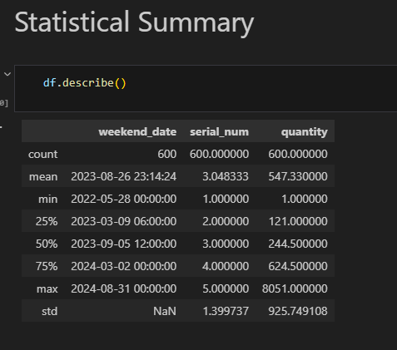
EDA notebook
Missing Values are printed for each column
Statistical summary such as min, max count and other statistical summary can also be calculated
The min quantity is 1 and maximum is 8051
The count is 600
The mean or average of quantities is around 500

Slide 8
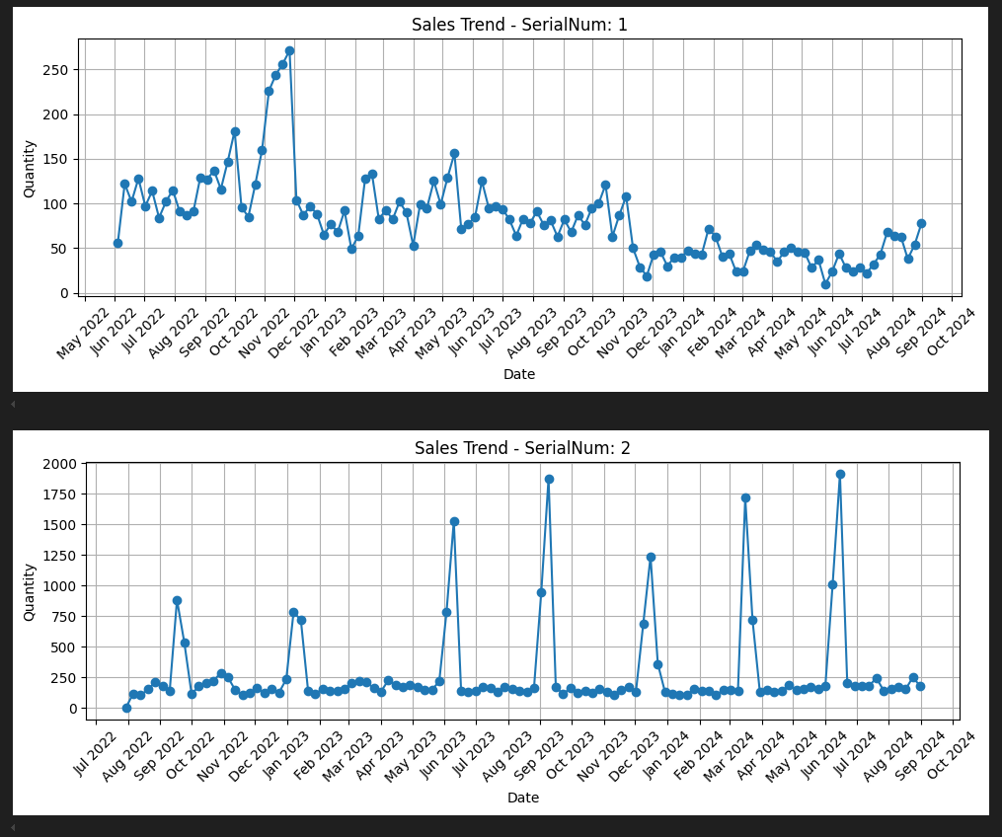
EDA notebook
Sales Trend are plotted with respect to each serial number
The following trend for serial no 1 and 2 is shown, similarly we find trends for serial number 3,4 and 5
One can decipher that the peaks or trends are found around oct, nov and dec 2022 for serial number 1.
Regular trends are found for serial number 2

Slide 9
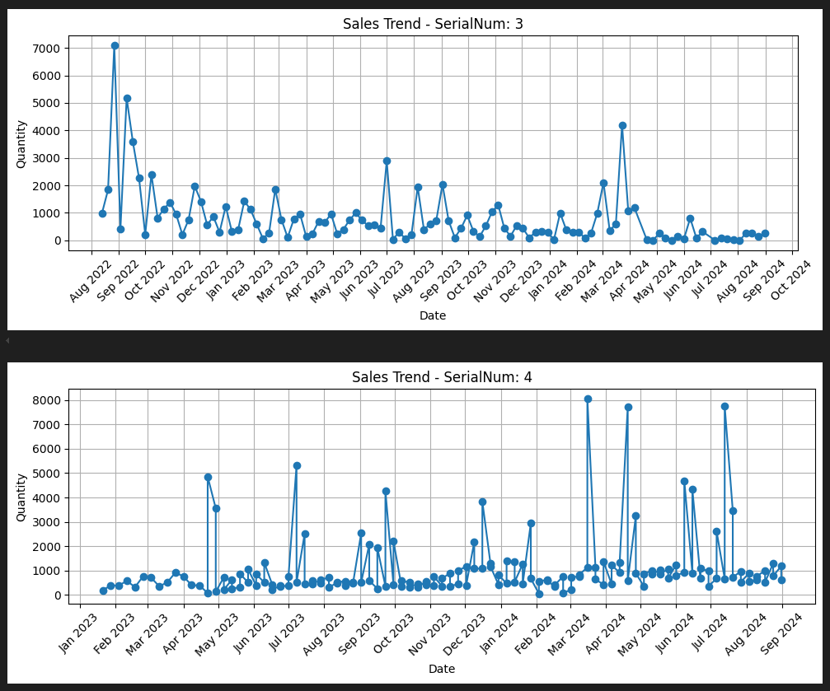
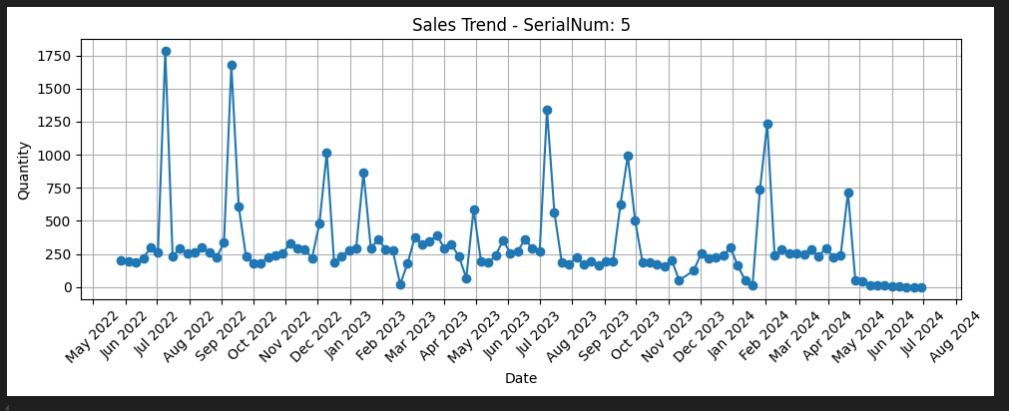
EDA notebook

Slide 10
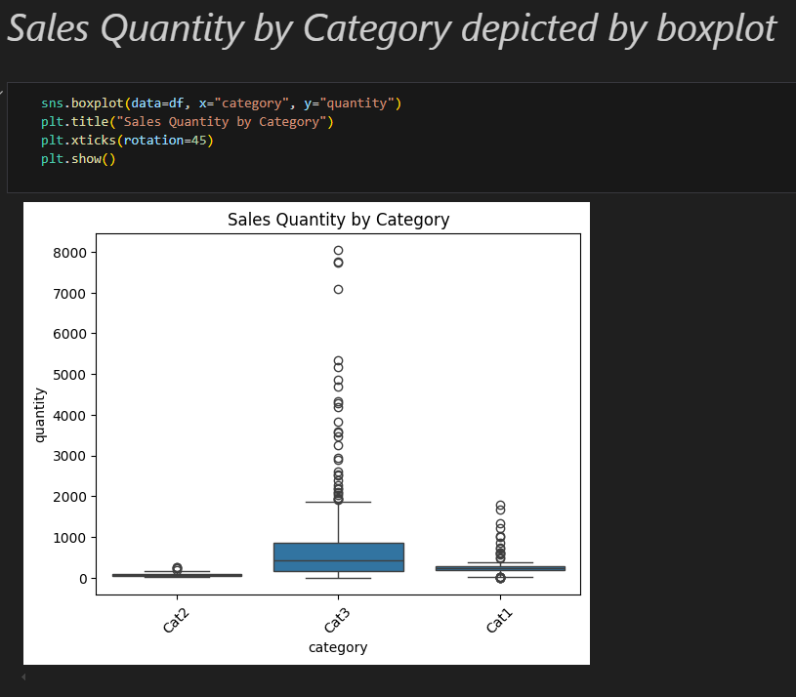
EDA notebook
We calculate the Sales Quantity by Category using boxplot
We find that the sales quantity for the cat3 category is highest with more outliers up to 8000 quantities sold
The boxplot states that the mean is mostly around 400 to 500 for cat3 but there are quantities sold more than 8000 also

Slide 11
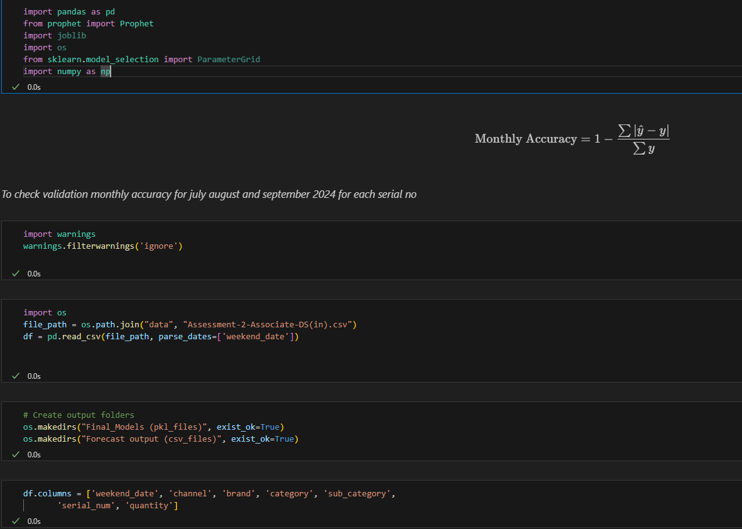
Forecast Modelling Notebook
This is the start of the Forecast Modelling Notebook
Usual imports are done
File is read and Output folders are set up to save our final pkl and csv files
Data frame Columns are normalised to small letters
We are currently performing Forecast on the Prophet model by Facebook/Meta

Slide 12
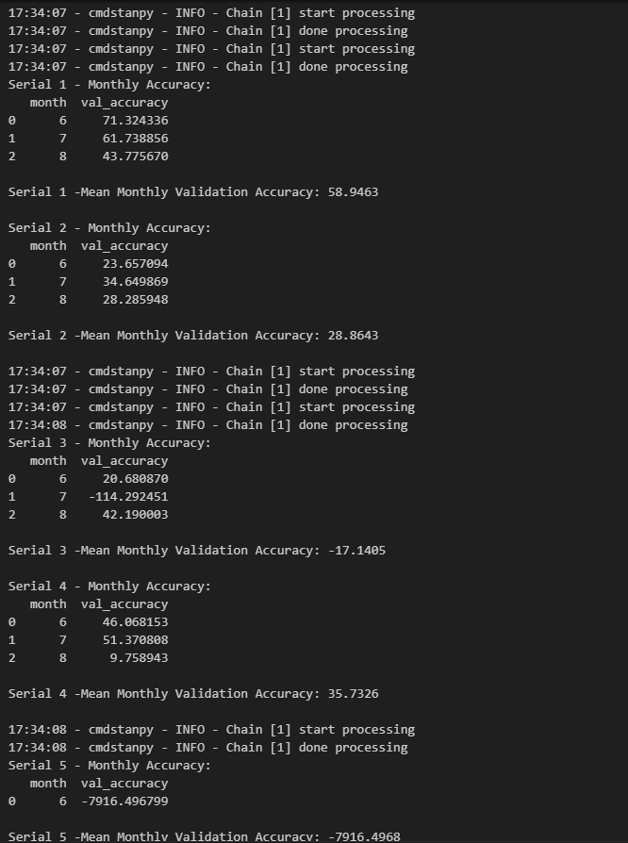
Forecast Modelling Notebook
We Loop through all unique serial numbers and run Prophet forecasting for each serial no and calculate the monthly accuracy for validation data months i.e. 6, 7 and 8 (june- July - august 2024)
And also Mean Monthly Validation accuracy is calculated for each serial number since there are three months in validation set

Slide 13
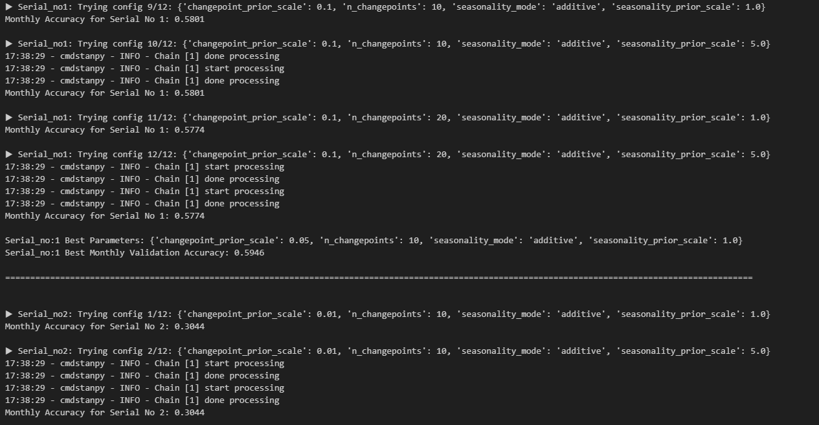
Forecast Modelling Notebook
Loop through all unique serial numbers and run Prophet forecasting for each hyperparameter configuration of the Prophet Model
There are a total of 12 configurations for each Serialno and we save the model with best params in pkl file
Serial no 4 has 2 Brands B1 and B2 hence we need to save Two models for it

Slide 14
Forecast Modelling Notebook
For Serial No 1 Model best accuracy is 59.46%
For Serial No 2 Model best accuracy is 30.44%
For Serial No 3 Model best accuracy is -0.1389
For Serial No 5 Model Best accuracy is -78.62

Slide 15
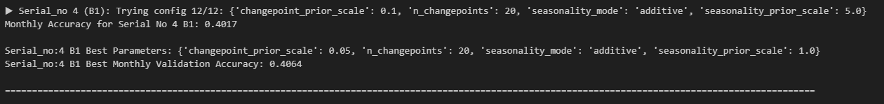
Forecast Modelling Notebook
For serial Number 4 since it has two Keys 4_B1 and 4_B2 hence we make two models for it
For Serial No 4 (B1) model accuracy is 40.64%
For Serial No 4 (B2) model accuracy is 0.0079

Slide 16
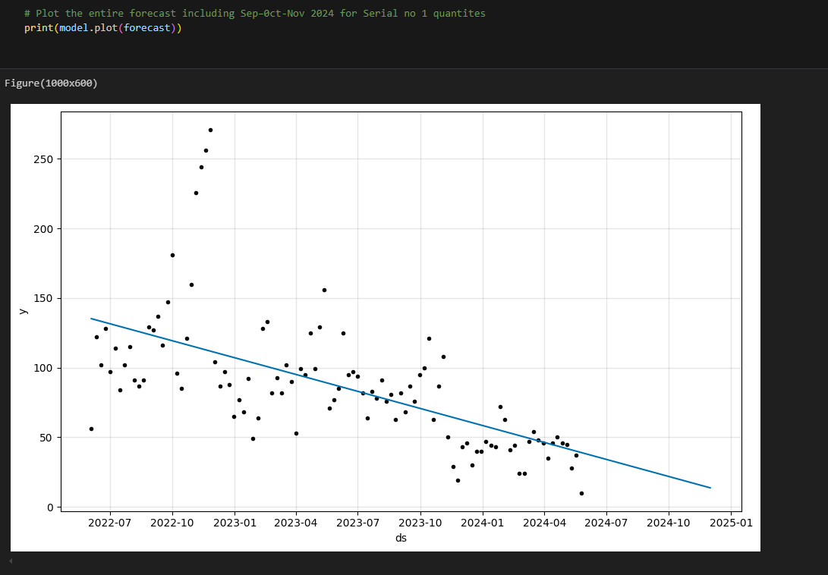
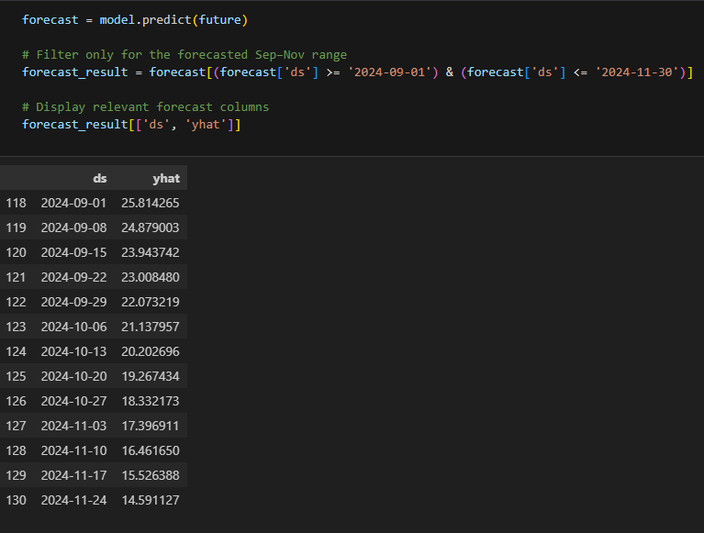
Forecast Modelling Notebook
Now we forecast the next 3 months quantity i.e. september, october and november 2024, using the saved .pkl best models for each Serial_No

Slide 17
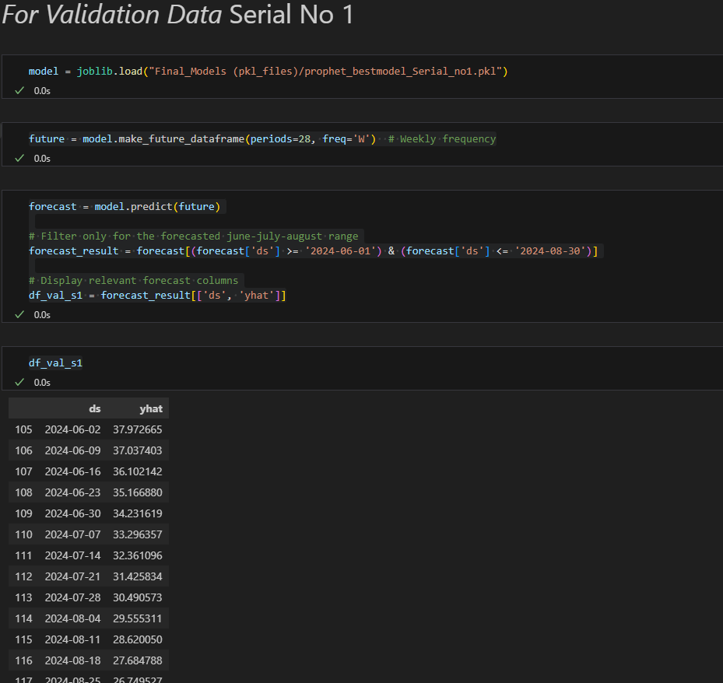
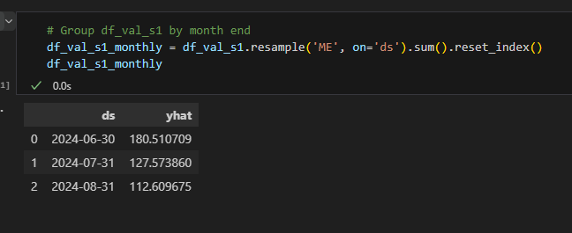
Forecast Modelling Notebook
And for each Validation Data Serial models we do the forecast

Slide 18
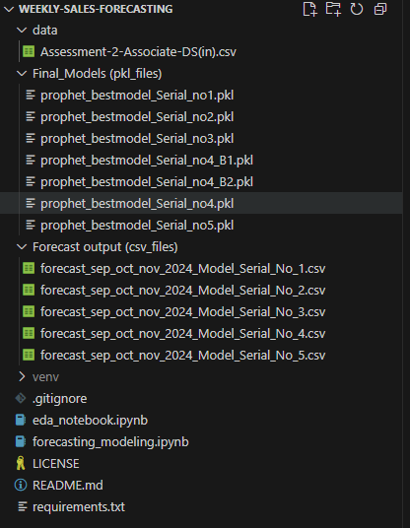
Final Folder with all the files for reference
GitHub Repo: Link
LinkedIn Profile: Link
CV/Resume: Link
Thank you…

